Slide 1


Welcome to the FSSU
Training Webinar for Treasurers

Slide 2


Topics
Introduction
Most important controls to have in place
Budget preparation
Treasurers report for the board meeting
Annual accounts submission
Fixed Assets Register
Other Internal Controls
Other functions
Notes:
Good evening everyone and welcome to the FSSU training webinar for treasurers of boards of management in primary schools. My name is Louise McNamara and I am Director of the FSSU. Bernadette Campion our Administrator is supporting the webinar this evening and will answer any questions you have around accessing the webinar. If you have any difficulty, you can email Bernadette directly on bernadettecampion@fssu.ie or put a question into the webinar questions box. Our FSSU Accounts Technicians XX, XX, XX are all here to answer your questions throughout the session. Joe Conlon, Manager of the primary side of the Unit will host the questions and answer session later.
I would like to start by thanking you for taking on the role of treasurer of the board of management. This is often a role that boards struggle to fill and I want you to know that we are here in the FSSU to support you in your role as treasurer. The treasurer is hugely supportive to the Principal and to the board in its entirety in ensuring good financial governance. This evening we are going to look at the legislative and compliance context of the role of treasurer just to give you some background on the reason and importance of the role. Then we are going to look at the most important controls to have in place straight away, these are the basics which will ensure the financial governance can be developed further. We held a budget preparation webinar last month which is available as a recording on our website and in case you didn’t get to attend or see the training video, we will look at this area again this evening. One of the most important functions for the treasurer is to prepare the finance report for the board meeting so we will take you through how to do this. Under the Education Act 1998, boards of management must submit annual accounts to the Department and this is done through compliance with the FSSU guidance in this area. This submission carried out by the external accountant, also ensure that the board is in compliance with the requirements of the Charities Regulator and the Central Statistics Office. Next, we will look at the fixed asset register which is a useful tool for boards to ensure that assets are controlled and we will take you through a sample of how you can compile and maintain an asset register. Finally, we will look at some other internal financial controls which should be in place and finally some other functions that the treasurer needs to be aware of. This may seem like a very comprehensive list but we have checklists and templates available that will make things easier for you!

Slide 3

Q&A Session at end of Webinar
Notes:
At the end of the webinar we will have a questions and answers session. We will base this on the queries you submit throughout the webinar and also share some of the most common questions we get regularly from treasurers.

Slide 4
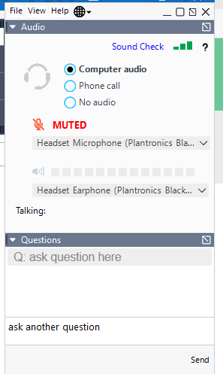
How to ask a Question
Notes:
Please feel free to ask any questions during the webinar by going to the control panel in the right had side of your screen and click on the questions button.
– under “ask question here”.
Type in your question and click the “Send” button.
One of my colleagues will reply to you directly.
A message will appear on your screen with the answer.

Slide 5




Useful Resources
Recording
Email
Financial Guidelines
www.fssu.ie
Notes:
This webinar will be recorded and an email with the link to the recording will be sent to all participants in the next few days. All of the material and guidelines that we refer to this evening are available on www.fssu.ie

Slide 6

Useful Resources
School Governance Manual for Primary Schools
FSSU Treasurers Manual
www.fssu.ie
Notes:
You will hear us refer to the School Governance Manual for Primary Schools throughout the webinar. This is published every 4 years by the Department of Education and is the governance manual for boards of management in all aspects of running a primary school. Earlier this year, we issued the Treasurers Manual which is a comprehensive guidance document that details the role and functions of the treasurer and contains useful information such as timelines and templates to support you in your role. This manual is available on our website. Speaking of our website, www.fssu.ie, all financial guidelines and templates are available here. We issue a financial guideline to all schools when for example the Department issues a circular on grant funding or the Revenue issues an update that is relevant to schools. There is a huge amount of information on the website and it is easy to search for whatever area of financial governance you need more information on.

Slide 7
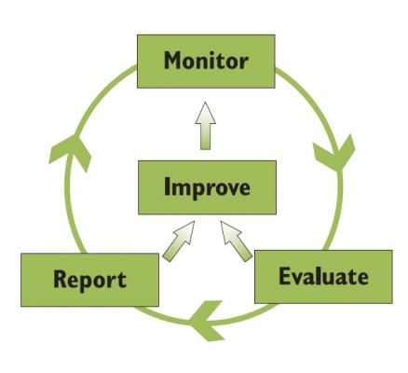
Topics
Introduction
Most important controls to have in place
Budget preparation
Treasurers report for the board meeting
Annual accounts submission
Fixed Assets Register
Other Internal Controls
Other functions
Notes:
So lets start by looking at the legislative context behind the role of treasurer

Slide 8
Introduction: Legislative Context
Education Act 1998
Under the Education Act 1998, the board of management is responsible for ensuring that the financial governance responsibilities of the board are met.
This means that the board must:
Adhere to the provisions of the Education Act 1998
Comply with the requirements of the ‘School Governance Manual for Primary Schools’ issued by the Department of Education every 4 years
Adhere to the requirements of the Charities Regulator
Comply with guidance and requirements from the Revenue Commissioners
Promote and adhere to best financial practice.
The board is accountable for all activities carried on under its auspices including those activities not financed or controlled by the Department.
Notes:
Education Act 1998
Under the Education Act 1998, the board of management is responsible for ensuring that the financial governance responsibilities of the board are met.
This means that the board must:
Adhere to the provisions of the Education Act 1998
Comply with the requirements of the ‘School Governance Manual for Primary Schools’ issued by the Department of Education every 4 years
Adhere to the requirements of the Charities Regulator
Comply with guidance and requirements from the Revenue Commissioners
Promote and adhere to best financial practice.
The board is accountable for all activities carried on under its auspices including those activities not financed or controlled by the Department. This would include renting the school building to an outside body or having a pre school on site for example

Slide 9

Introduction: Legislative Context
Section 12 of the ‘School Governance Manual for Primary Schools 2019-2023’ relates to the role of the treasurer and states the following:
Each board of management shall elect a treasurer from amongst its members
The chairperson, Principal or the teacher nominee shall not be the treasurer
The treasurer shall keep the school accounts and ensure that proper books of accounts are kept in line with best practice guidelines. A bank reconciliation statement for each school account is prepared once a month
The treasurer should monitor all grants from the Department of Education
The treasurer shall present at each meeting of the board an up-to-date statement of the school accounts, giving details of income and expenditure since the previous meeting
The treasurer shall be a signatory on all school bank accounts
The treasurer shall retain vouchers of expenditure for inspection and audit by the school accountant and officials from the Department of Education
All documentation relating to financial transactions and purchasing is signed by the treasurer.
Notes:
Section 12 of the ‘School Governance Manual for Primary Schools 2019-2023’ relates to the role of the treasurer and states the following:
Each board of management shall elect a treasurer from amongst its members
The chairperson, Principal or the teacher nominee shall not be the treasurer
The treasurer shall keep the school accounts and ensure that proper books of accounts are kept in line with best practice guidelines. A bank reconciliation statement for each school account is prepared once a month
The treasurer should monitor all grants from the Department of Education
The treasurer shall present at each meeting of the board an up-to-date statement of the school accounts, giving details of income and expenditure since the previous meeting
The treasurer shall be a signatory on all school bank accounts
The treasurer shall retain vouchers of expenditure for inspection and audit by the school accountant and officials from the Department of Education
All documentation relating to financial transactions and purchasing is signed by the treasurer.
This list is not exhaustive. However, there is no implication that the treasurer must physically carry out all of the tasks outlined above. Many of these tasks can be delegated, for example to the school secretary, who in many schools maintains the accounting records for the board. It is the responsibility of the school board of management to ensure that the necessary structures are in place as the board is responsible for all business carried out in connection with or on account of the school.

Slide 10

Introduction: Legislative Context
Charities Act 2009
All schools are registered charities
Registered Charity Number
Fundraising
Annual Return
Updating Board of Management Members details
Notes:
Under the Charities Act of 2009, all schools are charities and the board of management are the trustees of the charity. Resulting from this, all boards must register the school with the CRA and obtain a registered charity number (RCN). Most schools have done this as it is essential to have this number in order to be able to complete submission of annual accounts to the FSSU every year. Obtaining an RCN only needs to be done once, the RCN issued remains the RCN of the school for the period of its existence. Every year in August, Schools must log into their CRA account annually and confirm that the data is correct. The data you will be confirming is the data submitted to us by your external accountant. Where a board member changes or when a new board is put in place every 4 years, the school must update the board details on the CRA account.

Slide 11
Fundraising​
It is critical that schools carry out all fundraising in an open, transparent, honest, respectful and accountable manner.
Funds given to charities can include money but can also include property and assets of any sort. The funds provided to charities will usually fall into one of the following three categories:
Restricted funds
Unrestricted funds
Designated funds.
The board must adequately identify, distinguish and report upon unrestricted, restricted & designated income to enable adequate reporting upon both income and reserves. The external school accountant will code these items at year end but will need to be made aware of them.
The CRA has issued a detailed guideline for charities - Guidelines for Charitable Organisations on Fundraising from the Public.
Notes:
Just looking at fundraising in a bit more detail. The Charities Regulator sets down provisions for fundraising by charities. As registered charities, it is critical that schools carry out all fundraising in an open, transparent, honest, respectful and accountable manner.
Funds given to charities can include money but can also include property and assets of any sort. The funds provided to charities will usually fall into one of the following three categories:
Restricted funds
Unrestricted funds
Designated funds.
Restricted funds are where fundraising takes place for a specific purpose eg a cake sale to fund the bus for the school tour. The funds generated in this case can only be used to fund the school tour
Unrestricted fundraising is where for example a no uniform day is held for the school – these funds can be used as the board sees fit for the needs of the school
Designated funds are where the board sets aside funds for a particular reason eg development of an Astro pitch
The board must adequately identify, distinguish and report upon unrestricted, restricted & designated income to enable adequate reporting upon both income and reserves. The external school accountant will code these items at year end but will need to be made aware of them.
The CRA has issued a detailed guideline for charities - Guidelines for Charitable Organisations on Fundraising from the Public.

Slide 12
Topics
Introduction
Most important controls to have in place
Budget preparation
Treasurers report for the board meeting
Annual accounts submission
Fixed Assets Register
Other Internal Controls
Other functions
Notes:
Next, I would like to take you through the most important controls to have in place

Slide 13

Most important controls to have in place!
Payment controls
No Debit Cards!
FSSU compliance annual accounts
Revenue compliance
Recording of income and expenditure & access to all accounting records held by the school such as original bank statements, correspondence, invoices, asset register and payroll records
Cash/cheque income
Notes:
These are the most basic controls that you as treasurer should make sure are in place. These are the basic issues but will mean that the board has made a good start in ensuring good financial governance.

Slide 14

Payments Controls
The treasurer must always be one of the approvers for payments
Chairperson – may delegate
Manual payments or electronic payments
Debit Cards
Credit Cards - Guideline P10 - 2021/2022
Petty Cash - see Help section of website
Notes:
Payment controls is the first one. As per the School Governance Manual for Primary schools, all payments leaving a school must be signed off by both the treasurer and the chairperson. The chairperson may delegate their signoff to another member of the board and where they do, this must be minuted. This applies to whether the payment is in the form of a cheque or an electronic payment, it still has to be the treasurer always together with the chairperson or their delegate. If you don’t already have electronic banking set up, you should prioritise this, it makes it much easier to issue payments and its cheaper than cheques. Make sure you set up business banking to allow for the two approvers and make sure the bank adhere to this requirement when setting it up. Never sign a blank cheque and always make sure you have the backup before signing a cheque or approving a payment online. Finally, as per the School Governance manual, debit cards are not allowed as they do not facilitate the rule of two approvers authorising all payments.
A school may operate a credit card, there should only be one credit card held by the Principal. The statement and supporting documentation must be reviewed and signed off by the treasurer and chairperson before the credit card bill is paid. If a board wants to apply for a credit card, patron approval is required in advance as this is a form of debt. There is a guideline on our website P10 – 2021/2022 that give more detail on credit cards. If there is petty cash in the school, this should be operated under the imprest system, there is further guidance on this on our website to which we have provided a direct link on this slide. And it should only be used for small amounts for eg up to 10 or 20 euros

Slide 15
Annual Accounts Submission
All boards must engage an external accountant to submit annual accounts on their behalf to the FSSU
When draft accounts have been completed by the external accountant, they are presented to the board for formal ratification and a copy sent to the patron
The annual school accounts must be formally adopted by the board of management before submission to the FSSU.
Board must ensure submission of the annual accounts to the FSSU by the 28th of February each year to ensure compliance with Section 18 of the Education Act 1998.
Annual financial reporting requirements of the Charities Act 2009 and the Central Statistics Office statutory requirements
Deadline
28th Feb
Notes:
All boards must engage an external accountant to submit annual accounts on their behalf to the FSSU as required under Section 18
When draft accounts have been completed by the external accountant, they are presented to the board for formal ratification and a copy sent to the patron/trustees
The annual school accounts must be formally adopted by the board of management before submission to the FSSU.
Board must ensure submission of the annual accounts to the FSSU by the 28th of February each year to ensure compliance with Section 18 of the Education Act 1998. This means the treasurer must follow up with the external accountant to make sure the February 28th deadline is met. If the annual accounts aren’t submitted to the FSSU by the 28th of February every year, then the school will be audited and its best to avoid this. Check with the external accountant that this has happened and if not, let us know why.

Slide 16
Revenue Compliance
The board is obliged to register for RCT / VAT
Public Body – are not allowed to claim a VAT input credit
Revenue Guidance Note
More Info
“Boards of Management – Relevant Contracts Tax/Value Added Tax”
File RCT / VAT via ROS and make payments to Revenue
Schools are subject to Revenue Audits
All employees of the board must be paid through payroll system
Notes:
Under legislation, the board of management is deemed to be a Principal Contractor and therefore must register and operate Relevant Contracts Tax and Reserve Charge VAT. As schools are public bodies they cannot claim back VAT.
For further information please see the guidance note issued by Revenue which is available on our website under the FAQ section.
It is a requirement that boards ensure that RCT / VAT is operated properly and returns and payments are made to Revenue on time. Many boards outsource this function so check to make sure it is being done correctly and on time.
All employees of the board paid by the board must be paid through the payroll system of the school and taxes deducted and remitted to Revenue.
Boards of management are not treated any differently by Revenue and are expected to comply fully. Make sure that any employees are paid through a payroll system and that revenue returns for paye/prsi and RCT and Vat are being done and are up to date.
Schools are subject to Revenue audits.

Slide 17
Recording of Income and Expenditure
Ensure there is a system in place to record income and expenditure -Excel based FSSU system or software package
Bank Reconciliations
Recommended reports – timely, accurate and reviewed
Notes:
In order for you as treasurer to be able to carry out your role, you need to have access to the income and expenditure of the school. So there needs to be a system in place that does this and that you can access for timely and accurate information. The treasurer should review the financial information systems within the school to ensure that the board has adequate information upon which to make decisions and to satisfy itself that the school finances are being managed in such a manner, as to meet its obligations to the school community, the patron, the Department of Education and other interested parties such as the Revenue Commissioners. This system can be in the form of an excel system such as the FSSU supported monthly template or some schools have a system like Sage or Surf. As treasurer, you need to have access to all financial records, related correspondence, invoices, bank statements and payroll reports

Slide 18
Cash/Cheque Income
Receipts
Cash collection process – at least 2 people involved
Electronic collection systems
Notes:
This is very important particularly where there is a lot of cash and cheques coming through the school. Make sure there is a system in place of receipts being issued and always at least two people involved in the collection and counting of cash and lodgement preparation. Many school have adopted electronic systems for the collection of income. These systems email receipts automatically and greatly reduce the risk that cash and cheques pose for boards of management. If your school doesn’t have one in place, its worth considering. All income received should be lodged intact, it is not good practice to keep some money out and use it to pay expenses. This distorts the true figures for income and expenditure.

Slide 19

Questions to ask?
Treasurer should be comfortable that:
the school is paying its bills on time
the school has sufficient funds to cover the liabilities
Accruals are part of the accounts - this is an expense that has been incurred but the invoice has not yet been received – manual list should be maintained
Notes:
Is the school paying its bills on time?
Has the school sufficient funds to cover the liabilities?
Are there accruals? This is an expense that has been incurred but the invoice has not yet been received – manual list should be maintained

Slide 20
Topics
Introduction
Most important controls to have in place
Budget preparation
Treasurers report for the board meeting
Annual accounts submission
Fixed Assets Register
Other Internal Controls
Other functions

Slide 21
Budget preparation: Why prepare a budget?
Objectives of budgeting
Control financial resources
Effective decision making
Patron requirements
Achieve the board’s administrative and educational objectives
Maximise use of available resources
Assist the Principal and treasurer to manage the finance on a day to day basis
Notes:
Next we are going to talk about budgeting. So why prepare a budget?
In line with the ED Act and the School Governance Manual for Primary Schools, the board is responsible for ensuring that the financial resources of the school are properly distributed to meet the needs of the school
Budgeting supports the board in doing this.
It allows for ongoing monitoring to make sure that overspending doesn’t occur
Patrons may require boards to submit a budget to them annually and it is good practice to do this anyway.
Budgeting supports the board to achieve the objectives outlined in their school plan.
Having a budget allows the board to plan spending and to avoid ad hoc decision making.
It is good financial practice and good financial governance to have a school budget in place. The Charities Governance code requires a budget to be in place and ongoing monitoring against actual activity monitored.

Slide 22
What do you need to prepare the budget?
The final annual accounts for the previous year prepared by the external accountant​
Enrolment data for next year
Year to date actual versus budget report
Planned spending for next year
Not an exact science!
Notes:
To start the process for compiling your budget, you should have the following information available:
Final accounts for the previous year
Reports that show the actual income and expenditure figures so far this year versus this years budgeted figures
And any plans for specific spending for next year
Remember, budgeting is not an exact science and if you don’t have exact figures yet, that’s fine. The template can be easily updated.

Slide 23
Timeline for budget preparation
WHO |  | ACTION POINTS
Treasurer, Principal, Board Members | Term 3 | Attend FSSU Budget Training Webinar
Treasurer and Principal | Term 3 | Compile draft budget using FSSU template (Expenditure cannot exceed income)
Full board | Term 3 | Ratify budget
Treasurer | Term 3 | Forward copy to patron/trustee
Treasurer | Term 1 (next year) | Enter budget figures on next year’s monthly reporting template
Treasurer | Ongoing | Review budget against actual figures every month
Notes:
Here is a suggested plan to help you with budget preparation. I mentioned the first step earlier, the FSSU budget workshop which was held last month. As I said the webinar is available on our website. We would suggest that a board starts to look at its budget for next year in term 3. Firstly, gather the information we looked at in the previous slide. Then the treasurer and Principal should prepare a draft. If you are struggling to ensure that expenditure does not exceed income, let us know and we will be able to help. The full board then reviews the draft and when the board is happy, this budget is ratified and a copy sent to the patron. The most important step is to use the budget, input it into your system when you start the next year and consistently compare it to actual income and expenditure to stay on track.

Slide 24
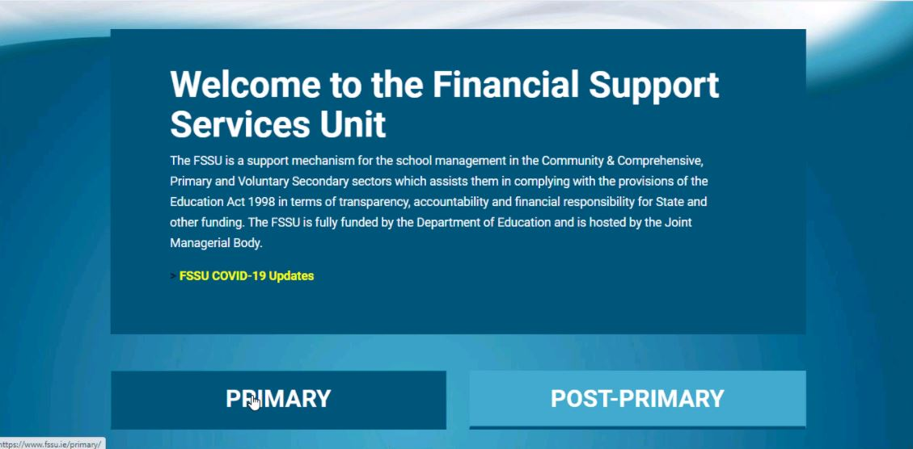
FSSU Budget Template 2022/2023
Notes:
.
The FSSU has developed a Budget 2022/2023 template. This template provides the automatic calculation of grant income. To locate the file, go to fssu.ie and click on primary.
.

Slide 25
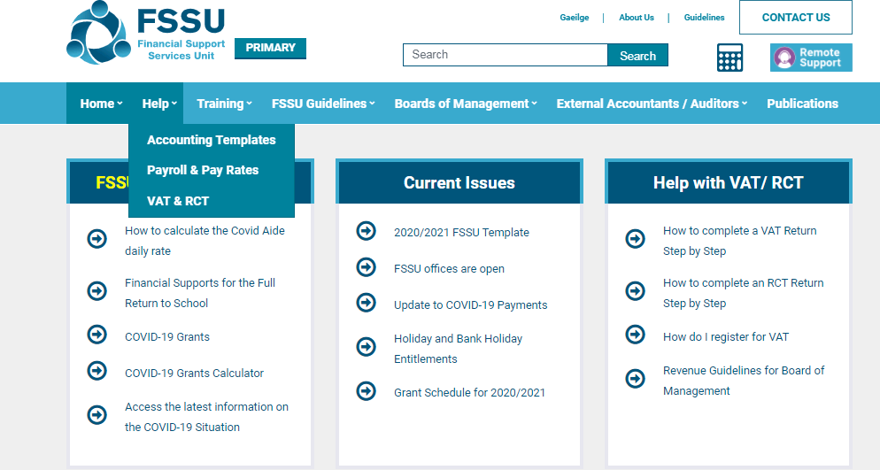
FSSU Budget Template 2021/2022
Notes:
Click on Help, and then accounting templates

Slide 26
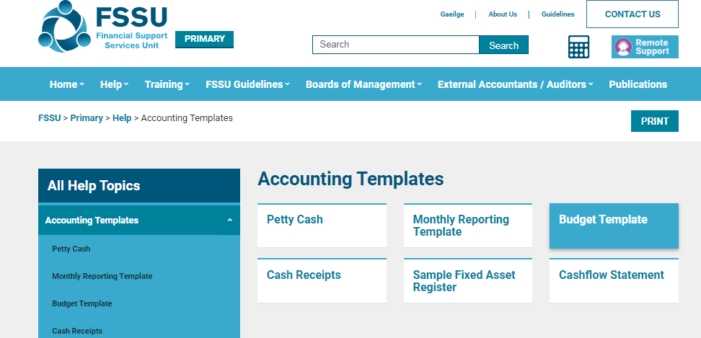
FSSU Budget Template 2022/2023
Notes:
And then click on the budget template

Slide 27
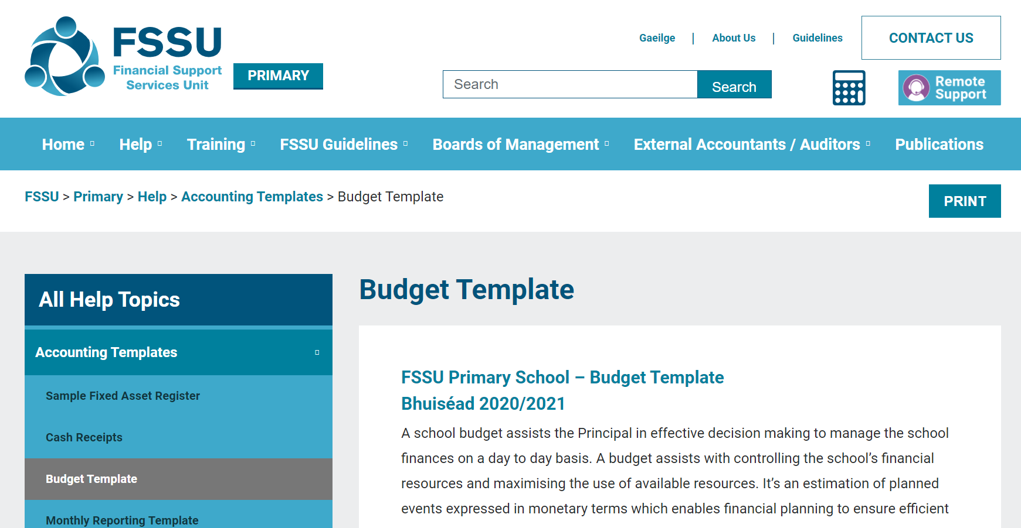
FSSU Budget Template
FSSU Primary School – Budget Template
Bhuiséad 2022/2023
Notes:
Then select this file

Slide 28
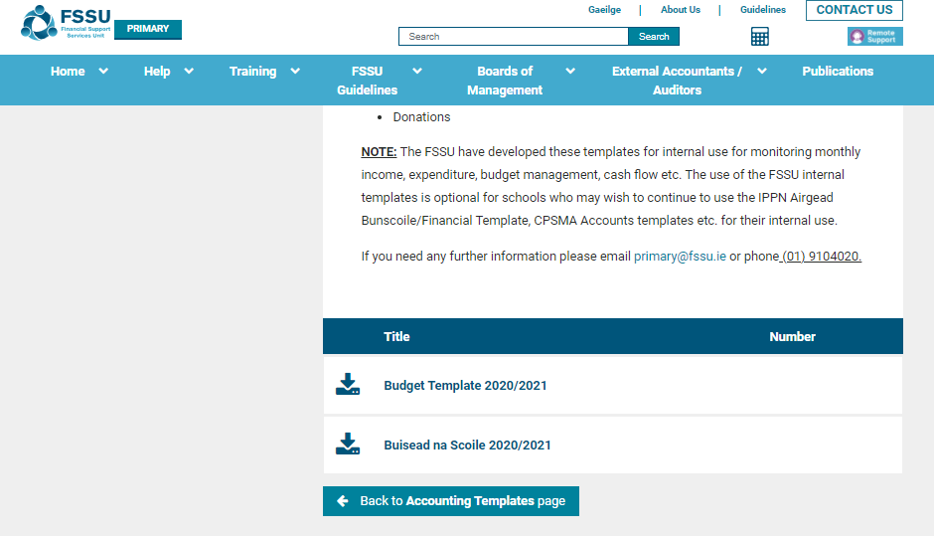
FSSU Budget Template
Budget Template 2022/2023
Bhuisead na scoile2022/2023
Notes:
The template is available in both English and as gaeilge

Slide 29
Topics
Introduction
Most important controls to have in place
Budget preparation
Treasurers report for the board meeting
Annual accounts submission
Fixed Assets Register
Other Internal Controls
Other functions
Notes:
Next we will look at the treasurers report for the board meeting

Slide 30

Treasurers report for the board meeting
Step 1: Review Financial
Reports
Checklist
Notes:
One of the biggest jobs for the treasurer is preparation of the finance report for the board meeting. We have developed a step by step guide for doing this. Step 1 is to print off and work through the financial reports checklist.

Slide 31

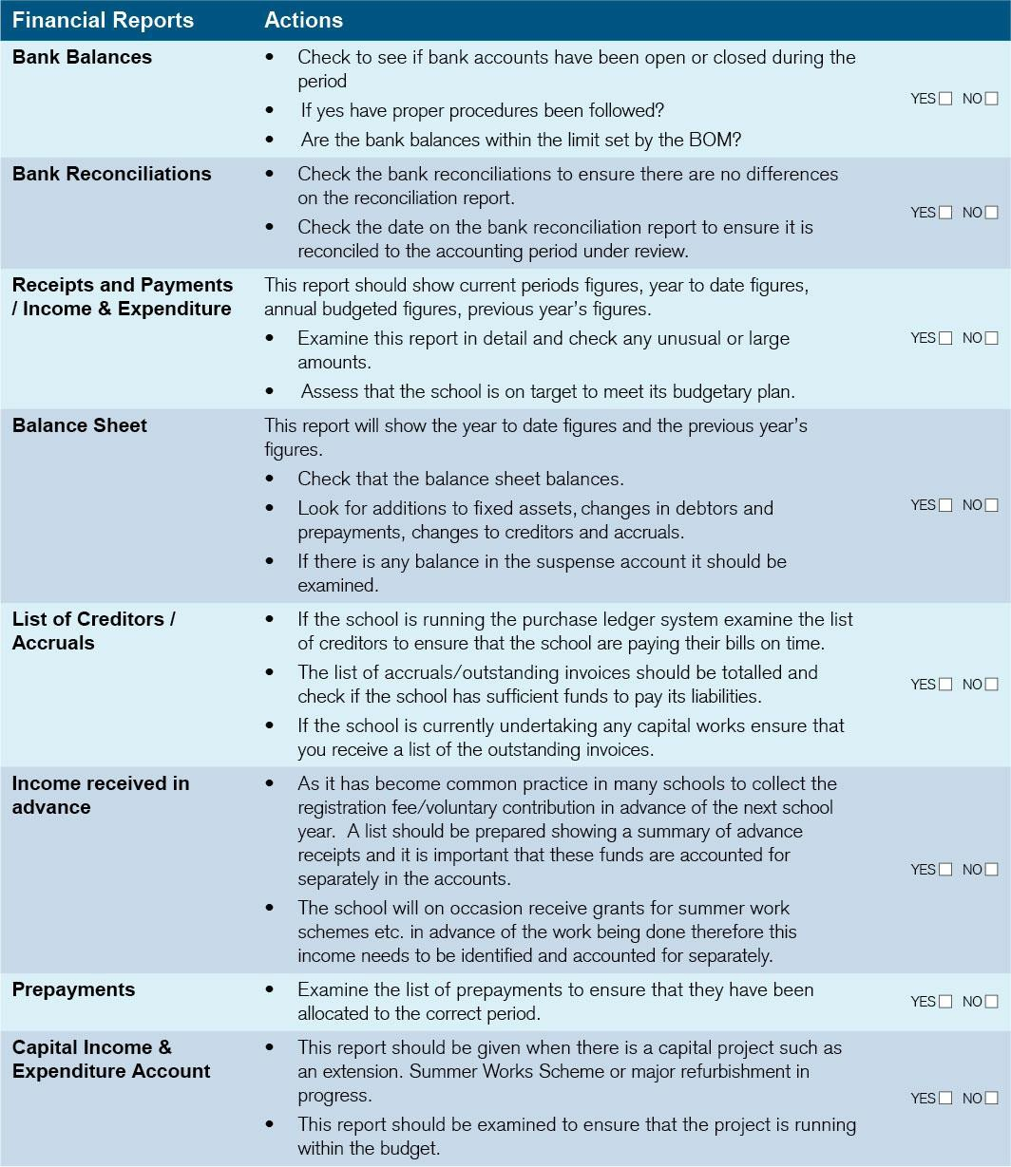
Treasurers report for the board meeting
(Pg 5 of Treasurers Manual)
Notes:
This checklist is available on page 5 in the Treasurers Manual and I suggest you print one out before each board meeting and file it with the minutes. It’s a great way to be sure that as treasurer you have addressed everything you need to. Some of the items on the checklist won’t happen regularly like, has a new bank account been opened. We are going to look at review actions for each of the sections of the checklist that will need to be looked at every month.

Slide 32
Step 2: Review the Financial Reports
List of Creditors/Accruals and Income received in advance
Bank Reconciliation Statement for all Bank Accounts
Income and Expenditure Account showing actual versus budget figures
Payroll Report
Capital Income and Expenditure Account(s)
Notes:
The next step in preparing your report flows from step one and it is to review the financial reports. Lets look at each one listed above and the review actions for each one.

Slide 33
Step 2: Review actions for Bank reconciliation for all Bank Accounts
Complete bank reconciliation for each bank account to the end of month date preceding the meeting
Ensure that there is no difference on each bank reconciliation statement
Ensure there is a bank reconciliation for each bank account
Go through the list of payments and receipts and look at backup documentation
Look at payments to personal names and ensure there is back up
A sample of invoices should be randomly selected and reviewed by the treasurer to the corresponding payment, invoice and delivery docket
Was all spending approved?
Are all bank accounts necessary? It is advised that the number of bank accounts be kept to a minimum. The chart of accounts used by schools allows for income categories to be identified separately even if the different income streams are lodged to the same bank account
Ensure that the treasurer and the chairperson sign and date each bank reconciliation
Have all payments been approved by both the treasurer and chairperson? Has the chairperson delegated their signoff to another board member and if so, has this been included in the minutes?
Notes:
When reviewing the bank reports, these are the steps to take

Slide 34
Step 2: Review actions for Bank reconciliation for all Bank Accounts (Cont’d)
Has the credit card statement been approved by the chairperson and treasurer?
If the board is using electronic banking, are the treasurer and chairperson both approving payments?
Are all credit card transactions backed up by a valid receipt? Is spending within the agreed limit?
Has all grant income due from the Department of Education been received?
Has ringfenced income been spent only on the purpose intended? For example, the Book Grant.

Slide 35
Step 2: Review actions Income & Expenditure Actual versus Budget report (Pg. 8 Treasurers Manual)
This report details all income and expenditure that went through the school bank accounts in the last month. Each income and expenditure amount are categorised into a code using the FSSU chart of accounts. The report shows what actually happened versus what was budgeted to happen.
Review actions:
Review each figure to ensure that each figure looks reasonable
Look at the difference between what has happened and what was budgeted. If expenditure, for example, of stationery has exceeded the budgeted figure, this will need to be addressed by cutting expenditure elsewhere or increasing income. Ensure the bottom line is still in a surplus/breakeven position.
Notes:
The next report to review is the Income and & Expenditure versus budget report. Sample reports are available in the treasurers manual. This report details all income and expenditure that went through the school bank accounts in the last month. Each income and expenditure amount are categorised into a code using the FSSU chart of accounts.
The budgeted figure is also on the report so any differences can be addressed. Make sure that whatever system you are using can produce this report. It is the only way the board can consistently ensure that they are staying on track throughout the year. Failure to consistently review actual versus budgeted figures can result in a nasty surprise at year end!
Review actions: read
One of the queries we deal with is when a school is short on cash. This can happen when grants are due and cash has run low. Our template includes a very useful cashflow statement that should be used to help allocate available funds.
Review each figure to ensure that each figure looks reasonable
Look at the difference between what has happened and what was budgeted. If expenditure, for example, of stationery has exceeded the budgeted figure, this will need to be addressed by cutting expenditure elsewhere or increasing income. Ensure the bottom line is still in a surplus/breakeven position.

Slide 36
Step 2: Review actions Creditors/Accruals/Income received in advance
In order for the board to be able to anticipate future cashflow and have a true view of the current financial situation, it is important to list invoices that have been received and are not yet paid or invoices that are due to be received. This list can be compiled each month by retaining all such invoices and a list of invoices due to be received, in a separate folder.
1
Similarly, the board should be aware of any income that has come into the bank account in the current school year, but which actually relates to the next school year. This can happen in the last term, for example, where book rental money for next year may be collected before the end of the current school year.
2
Review actions:
3
Are the invoices addressed properly to the board?
Has the work been completed satisfactorily?
Have the anticipated costs been approved by the board?
Has all income received in advance been separated into its own code?
Notes:
The next area to review is creditors, accruals and income received in advance.

Slide 37

Step 2: Review actions Payroll
The ’Gross to Net’ report from the payroll system of the school should be reviewed and signed off by the Principal and the treasurer. This report details the gross pay of each employee and shows what has been deducted for tax, PRSI, USC and any other deductions, leading to the net amount, which is the amount that the employee receives.
Review actions:
Are all board paid employees listed on the payroll reports?
Have any changes to pay rates been approved by the board?
Have payments to selection committee members been processed through payroll?
Do all employees have a contract of employment?
Has the PAYE/PRSI/USC been paid over to Revenue?
Notes:
Payroll reports for board paid employees need to be reviewed as part of preparation for the finance report.

Slide 38

Step 2: Review actions Capital Projects
Where the board has undertaken a capital project such as a building project, it is important that the related income and expenditure for this project is separately monitored.
Review actions:
Review each figure to ensure that each figure looks reasonable
Is the board still operating within the income ringfenced to fund this project?

Slide 39
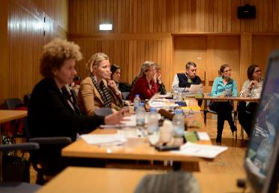
Step 3: Presenting the report to the Board meeting
When the treasurer has completed their review with the Principal, and another board member if required, a summary of the important issues should be compiled and presented to the full board. At a minimum, the report should contain:
Reconciled bank balances on all bank accounts
Total income and expenditure for the year-to-date and if this is within budget
Capital project update if applicable
Outstanding invoices and creditors
Any issues the treasurer has identified as part of the detailed review
The treasurer should address any questions from the board members
The report should be formally approved by the board and noted in the minutes.
Notes:
As with all board information and discussions, finances of the board are highly confidential. It is recommended that one copy of the finance report is held with the minutes of the full board meeting and any other copies are shredded.

Slide 40
Topics
Introduction
Most important controls to have in place
Budget preparation
Treasurers report for the board meeting
Annual accounts submission
Fixed Assets Register
Other Internal Controls
Other functions

Slide 41

FSSU Compliance - Annual Accounts
Annual Accounts
Deadline 28th Feb annually
Accounts signed by the chairperson and another member of the board ​
External accountant to complete the online submission to the FSSU​
BOM Authorisation Letter
Patron/trustee
Deadline
28th Feb
Notes:
I mentioned this earlier, but I would like to come back to it as it is a very important compliance issue for the board.
The submission date for the 2020/2021 accounts was the 28 February 2022, if you have not already submitted your accounts please do so immediately.
Each board of management is required to submit a copy of the annual accounts to the FSSU by the 28th of February each year to ensure compliance with Section 18 of the Education Act 1998. The annual school accounts should be formally adopted by the board of management before submission to the FSSU. A copy of the approved accounts should be forwarded to the patron.
All boards must engage an external accountant to prepare and submit annual accounts on their behalf to the FSSU. Boards that ensure their accountants submit to us on time are deemed to be in compliance with the requirements of Section 18 of the Education Act 1998, the annual financial reporting requirements of the Charities Act 2009 and the Central Statistics Office statutory requirements
The external accountant will prepare the boards accounts using the accruals basis for accounting and present them in the FSSU standard format.
The treasurer ensures that all accounts and documentation that the external accountant needs are prepared for the external school accountant at the end of the school year and that the submission is with the FSSU by February 28th
The Chairperson and another Board member must sign the accounts on behalf of the board. Type signed accounts are acceptable.
The Board of Management Authorisation Letter must be completed by the board in order for the accountant to file data on the board’s behalf.
Boards that have not submitted to us on time and consequently in breach of the compliance obligations to the Department of Educaiton, the CRA and the CSO and will be subject to audit by the DE. If your external accountant consistently misses this deadline and the board has provided all the information in a timely manner, the board needs to consider moving to an accountant that will support the compliance requirements of the board.

Slide 42
FSSU Compliance - Annual Accounts
School Annual Accounts Preparation Stages | Date Deadline
The board supplies all necessary financial information to the external school accountant for the school year ending on the previous August 31st | September 30th
The draft annual accounts are returned by the external school accountant | November 30th
Once the board is satisfied that the accounts are an accurate reflection of the school’s financial situation, they are formally ratified by the board, signed by the chairperson and one other board member | December 31st or earlier as required by the patron
External school accountants/auditors are required to access a secure online cloud-based system and to input the school trial balance and to upload a PDF copy of the approved annual accounts | February 28th
Notes:
Here is a suggested timeline that will help you to ensure that the annual accounts are submitted on time. In September…

Slide 43
FSSU Compliance - Annual Accounts Checklist
(Page 12 of Treasurers Manual)
Notes:
We have compiled a checklist to help the treasurer get everything together for the external accountant to prepare the annual accounts. This is available on page 12 in the treasurers manual. Again, tick as you go along and it will ensure that everything the accountant needs will be ready.

Slide 44
Topics
Introduction
Most important controls to have in place
Budget preparation
Treasurers report for the board meeting
Annual accounts submission
Fixed Assets Register
Other Internal Controls
Other functions

Slide 45
Fixed Assets Register​
Notes:
Read

Slide 46
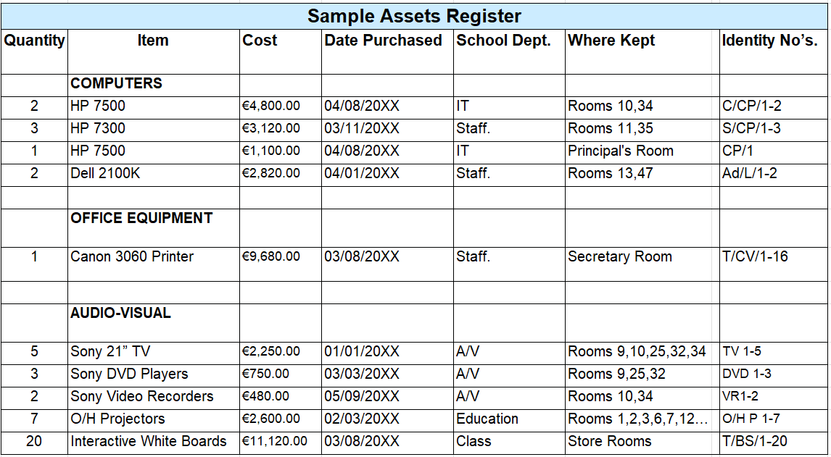
Sample Fixed Assets Register
Link to Excel file
Notes:
This is a simple example of a fixed asset register and we have also provided a link above to the Excel file on our website. The most important thing is that high value items such as laptops and specialised equipment are listed and can be tracked. An excel version is available on our website.

Slide 47
Topics
Introduction
Most important controls to have in place
Budget preparation
Treasurers report for the board meeting
Annual accounts submission
Fixed Assets Register
Other Internal Controls
Other functions

Slide 48

Other Internal Controls
Purchasing procedures and tendering procedures should be followed to ensure that best value for money is achieved
Three quotes should be obtained where possible for purchases and for large projects, e.g. purchase of white boards for the full school. Please contact the Schools Procurement Unit for assistance with tendering and access to existing OGP contracts - procurementsupport@spu.ie
The FSSU provides templates and guidelines on all financial internal controls. Please see our website www.fssu.ie. If there are any specific requirements, please contact us and we will assist you.
If you would like to receive financial guidelines directly, please send your contact email and school roll number to primary@fssu.ie. This will ensure that you receive all the guidelines issued and notifications of training webinars
Notes:
Read
Read

Slide 49
Topics
Introduction
Most important controls to have in place
Budget preparation
Treasurers report for the board meeting
Annual accounts submission
Fixed Assets Register
Other Internal Controls
Other functions

Slide 50

Other functions
(page 18 of Treasurers Manual)
Notes:
Read

Slide 51
Further training requests?
Please telephone or email us
FSSU Primary 01 910 4020
Email primary@fssu.ie
Notes:
So thank you for your time, I hope you found the session helpful. If there is any further training that you would like us to do, please let us know. I will now hand over to Joe Conlon the FSSU Primary Manager to host the question and answer session. Thank you again.

Slide 52

Question & Answer Session

Slide 53
Thank you for joining the webinar
If you have any further questions
please telephone or email us
FSSU Primary 01 910 4020
Email primary@fssu.ie

