Slide 1
Financial Update and
School Budget 2022/2023 Webinar
Community & Comprehensive Schools
March 2022
Notes:
Welcome to Financial update and School budget webinar for Community & Comprehensive schools. My name is Lorraine Guinan. I am also joined this morning by my colleagues Eileen Ahern, and Liz Lambert.

Slide 2
Webinar
Recording
Email
Handouts
Q&A
www.fssu.ie
Questions
Notes:
This webinar is being recorded and all attendees will receive an email within the next 24 hours with a link to the recording of the webinar. If you wish, the presentation slides can be downloaded from the handout section on your control panel. The presentation and slides will also be available on our website. I invite you to submit any questions you have through out the webinar in the questions & answer box on your control panel. We will respond to the questions as we go along. At the end of the webinar, we will address the most frequently asked questions.

Slide 3
Contact Us​
Eileen Ahern
Accountant
Lorraine Guinan
Accountant
FSSU Office
Mobile:
086-8519116
Email:
eileenahern@fssu.ie
Mobile:
086-7018874
Email:
lorraineguinan@fssu.ie
Phone no:
01-2690677
Email:
info@fssu.ie
Notes:
If you have any queries on the topics covered during the financial update section or require assistance with your budget template, please do not hesitate to contact either myself or eileen. Our contact details are on the screen now and we will put these up again at the end of the webinar.

Slide 4
Agenda
Financial Update
School Budget 2022/2023
Notes:
Our agenda for the webinar this morning is for the first part of the webinar we will have a financial update on topical issues relevant to the schools which I will take you through and then Eileen will take you through the preparation of the school budget for year 22/23.

Slide 5
Financial Update​
Government Budget 2022
Accounting for COVID 19 Grants
Updated Chart of Accounts
Charities Regulator
Salary increases in Oct 21 & Feb 22
Notes:
For the financial update section we will look at the key changes to the payroll taxes announced in the government budget in October 2022
We will look at the wages increases that applied from the 01st Oct 2021 and the 01st February 2022
We will look at the schools ongoing requirements to the CRA
I will also briefly mention the updated chart of accounts that issued in September last.
I will review accounting for the covid grants and the importance of using the correct nominal codes

Slide 6
Financial Update​
Travel and Subsistence
Impact of Brexit
RCT
VAT Update
Notes:
We will look at the revised claim form for travel and subsistence and the sample travel and subsistence policy for schools
I will cover the changes to the vat registration rules for public bodies and what impact it had for schools
We will look at the impact of Brexit on purchasing goods from the UK
Then lastly as part of the financial update section we will do a refresher on rct

Slide 7
Government Budget 2022​
Universal Social Charge (USC)
The exemption threshold of €13,000 remains the same. The ceiling of the 2% band will increase from €20,687 to €21,295, so that the salary of a full-time worker on the minimum wage will remain outside the higher rate of USC.
National Minimum Wage
The Government has approved increasing the national minimum wage by 30 cent per hour, from €10.20 to €10.50 from 1 January 2022.
PRSI
Employers currently pay 11.05% Class A employer PRSI on weekly earnings over €398. This increased to €410 from 1 January 2022.
Guideline 13-2021/2022
Notes:
Beginning with the key changes to the payroll taxes announced in the last government budget . The changes on screen took effect from 1st January 2022.
The exemption threshold for the USC of €13,000 remains the same. The ceiling of the 2% band will increase, so that the salary of a full-time worker on the minimum wage will remain outside the higher rate of USC.
The Government approved increasing the national minimum wage by 30 cent per hour, from €10.20 to €10.50 from 1 January 2022.
The employers PRSI rate of 11.05% for Class A employees on weekly earnings over €398 will increased to €410 from 1 January 2022. Your payroll provider will have updated your computerised payroll package to take into account the changes to the rates of employers PRSI & the USC band.

Slide 8
Revised Salary Rates from 01st October 2021
Annual basic scale salaries were increased by 1% or €500 whichever was the greater.
Revised salary scales are detailed in Circular 0054/2021
Increase only applies to Department sanctioned clerical, caretakers and cleaning staff
Increase does not apply to school staff funded by the SSSF grant or other funds
1st October 2021
Guideline 12-2021/2022
Notes:
I am going to go through the pay increases that should have been applied on the 01st Oct and 01st Feb. So looking firstly at the pay increases from the 01st October 2021
Under the terms the New Public Service Agreement, whole-time annual basic scale salaries were increased by 1% or €500 whichever was the greater.
Revised salary scales for school secretaries, caretakers and cleaning staff, which are inclusive of the 1% increase, are detailed in Circular 0054/2021. Circular 54/2021 applies to sanctioned Department staff only paid from the NTP grant. This increase does not apply to secretaries, caretakers, cleaners, etc who are paid directly by the board and funded from the SSSF grant or general school funds. Again this increase should have only been given to those staff listed as department sanctioned staff on the school census.

Slide 9
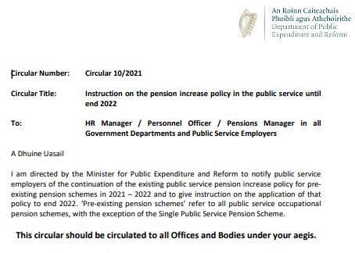
Pension Increases 01st October 2021
DPER Circular 10/2021
To calculate the increase due you will need the following;
Point on the scale at which the pensioner retired at
Pension decimal which was used to calculate the annual pension
Letter received by the school from the Department with the pension entitlements will contain the above information
Notes:
All school’s should have received an email from the Department of Education in November last with a copy of DPER circular 10/2021 setting out the pension increase policy in the public service until the end of 2022. This circular applies to any pensioners on the school payroll. This circular encompasses increases on the 01st October 2021, 01st February 2022 and the 01st October 2022
In order to calculate if any pensioners on the school payroll are entitled to an increase in their annual pension you must know the following 1) the point on the scale at which the pensioner retired at and 2) the pension decimal which was used to calculate the annual pension
Both of these can be found on the letter the school received from the Department of education at the time the individual was retiring.

Slide 10
Pension Increases 01st October 2021
Box 1 | On Retirement
Pensioners Name | Clerical Officer
Scale at retirement | Grade III Clerical Officer
Point on the scale at retirement | LSI
Pension decimal | 0.0587
Box 2 | 30/09/2021
Annual Salary per CL 0065/2020 | €40,590
Pension decimal | 0.0587
Annual pension | €2,382.62
Box 3 | 01/10/2021
Annual Salary per CL 0054/2021 | €41,090
Pension decimal | 0.0587
Annual pension | €2,411.98
Increase – annual | €29.35 (€2,411.98-€2,382.62)
Increase – weekly | 0.56c (annual divide by 52.18)
Notes:
If we look at an example of a retired clerical officer that is been paid a pension on the school payroll. In box 1, the blue box on your screen we have the information on retirement, the clerical officer retired on the Grade III clerical officer scale and point LSI. The pension decimal used to calculate her annual pension was 0.0587 as per the letter received from the Department of Education at the date of retirement.
In box 2, the green box, the clerical officers annual pension at the 30/09/2021 was €2,382.62 and this is taken from the school payroll record.
In order to find out if the increase applies and if it does how much it is we need to find the salary for a Clerical officer on Grade III point LSI from the 01/10/2021 in the Circular 0054/2021 (flick to next slide). In box 3 the orange box, is the calculation on the
1st October. We know that the LSI salary from the 01/10/2021 is €41,090
We multiple this by 0.0587 to give us the revised annual pension of €2,411.98
This is an annual increase of €29.35 in the pension or if they are paid weekly it is €29.35 divide by 52.18 to get a 56c increase

Slide 11
Pension Increases 01st October 2021
Notes:
In circular 0054/2021 appendix 1 sets out the salary scales for clerical officer and we can see that the LSI salary is €41,090 (flick back to previous slide)

Slide 12
Revised Salary Rates from 01st February 2022
Annual basic scale salaries were increased by 1%
Revised salary scales are detailed in Circular 0007/2022
Increase only applies to Department sanctioned clerical, caretakers and cleaning staff
Increase does not apply to school staff funded by the SSSF grant or other funds
1st February 2022
Guideline 25-2021/2022
Notes:
From the 01st February 2022, whole-time annual basic scale salaries were increased by 1%. Revised salary scales for school secretaries, caretakers and cleaning staff, which are inclusive of the 1% increase, are detailed in Circular 0007/2022. Again this circular only applies to sanctioned Department staff paid from the NTP grant. This increase does not apply to secretaries, caretakers, cleaners, etc who are paid directly by the board and funded from the SSSF grant or general school funds.

Slide 13
Pension Increases 01st February 2022
Box 1 | On Retirement
Pensioners Name | Clerical Officer
Scale at retirement | Grade III Clerical Officer
Point on the scale at retirement | LSI
Pension decimal | 0.0587
Box 3 | 01/02/2022
Annual Salary per CL 0007/2022 | €41,501
Pension decimal | 0.0587
Annual pension | €2,436.11
Increase – annual | €24.13 (€2,436.11-€2,411.98)
Increase – weekly | 0.46c (annual divide by 52.18)
Box 2 | 01/10/2021
Annual Salary per CL 0054/2021 | €41,090
Pension decimal | 0.0587
Annual pension | €2,411.98
Notes:
I am going to take you through another example of how this applies to the retired pensioner on the payroll.
If we take our retired clerical officer again as an example.
In box 1, the blue box, we have the retired clerical officers scale at retirement, the point on the scale at retirement and the pension decimal. Remember this information will not change.
Based on our calculations at the 01/10/2021 the annual pension was €2,411.98 as per box 2
So now we need to find out what the increase in the pension is from the 1st Feb 2022. We need to find the new LSI salary for a Clerical officer on Grade III (flick to next slide).
In box 3 the orange box, we know that the LSI salary from the 01/02/2022 is €41,501
We multiple this by 0.0587 to give us the revised annual pension of €2,436.11
This is an annual increase of €24.13 in the pension or if they are paid weekly it is €24.13 divide by 52.18 to get a 46c increase

Slide 14
Pension Increases 01st October 2021
Notes:
In circular 0007/2022 appendix 1 it sets out the salary scales for clerical officer and we can see that the LSI salary is now €41,501 (flick back to previous slide)

Slide 15
Charities Regulator​
Update members details
RCN number
-on school headed paper
-website
-fundraising material
Check correspondence on the CRA ‘My Account’
Guideline 18-2021/2022
Notes:
The Charities Act 2009 requires all boards of management to register their schools with the Charities Regulator. The schools current requirements to the Charities regulator are;
Board of Management Members details need to be kept up to date with the CRA. When a new board of management commences their term of office or there have been changes to the board membership, these changes must be reflected in the school’s account with the Charities Regulator.
On receipt of the Registered Charity Number (RCN), the board should ensure that this number is shown on the school website, any fundraising material and is also included on the headed paper of the school.
Please note that all correspondence to and from the Charities Regulator in relation to the school must be conducted through the “Messages” option in MyAccount on the CRA website. Therefore, schools are required to log in regularly to check for messages and updates.
Guideline 18 of 2021/2022 contains more details on how to update members details

Slide 16
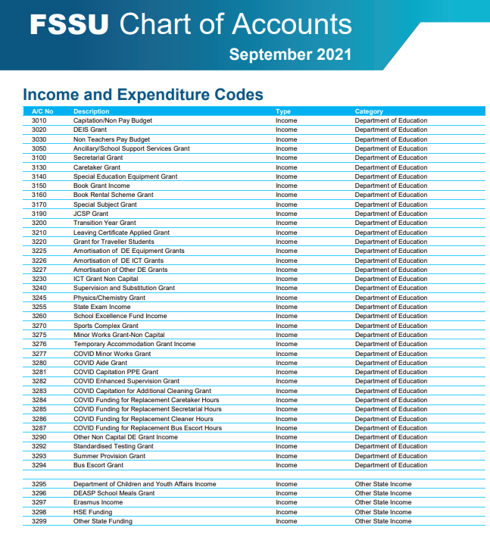
Update to the Chart of Accounts
Update to the Chart of Accounts
Codes added
Codes removed
Change of description to nominal codes
Guideline 02-2021/2022
Notes:
The chart of accounts was updated in September last. The chart of accounts is available on the FSSU website. Our guideline number 02 of 2021/2022 sets out the changes to the chart of accounts
➢ Table A of the guideline lists the New nominal accounts added to the chart of accounts.
➢ Table B of the guideline lists the Nominal accounts that are removed from the chart of accounts.
➢ Table C of the guideline lists the Change of description to the nominal accounts.
It is important that the school’s chart of accounts is aligned to the FSSU Chart of Accounts.
The school’s external accountant/auditor will use the revised chart of accounts when preparing the school’s annual accounts.
Therefore, it is advised to compare the current list of nominal codes in your school’s accounts package with this revised chart of accounts to ensure that both are in alignment. Please contact the FSSU if you require further guidance and support on the alignment of the chart of accounts.
The Chart of accounts that you are working from should be dated September 2021 as shown on your screen.

Slide 17
Accounting for COVID-19 Grants
Identify grant
Identify expense
Reconciliation
Unspent grant
Backup documentation
Notes:
Moving on to looking at accounting for COVID 19 grants.
During this pandemic a number of financial supports in the form of COVID-grants were made available to schools to allow for the full and safe reopening of the schools. These supports are made available to all primary and post-primary schools in the free education scheme.
Schools were required to identify and record all expenses paid from out of the COVID grants. The chart of accounts has been updated to incorporate COVID grant income and expenditures codes. Schools were also advised to set up a department called COVID in the accounts package to assist with reporting on the covid grants.
It is important that the purpose for which the grant is received is identified and accounted for under the correct grant code.
The corresponding expenditure of that grant must be correctly identified & accounted for under the correct expenditure code.
The school must be able to provide a reconciliation of the grant income received, the grant expenditure and the amount of the unspent grant remaining if any.
NEXT SLIDE

Slide 18
Accounting for COVID-19 Grants​
DE COVID Grant | FG | Balance sheet Code Unspent | Example of what it can be spent on | Expense Code | Income code
COVID Minor Works (Non-capital) | 48 | 2169 | Rental of additional space/rooms | 5316 | 3277
COVID Minor Works (capital) | 48 | 2169 | Used for the purpose of construction, alternation, extending the school building or structure | 3941 | 3905
 | 48 | 2169 | Used to purchase HEPA air cleaner unit, additional furniture for outside, single desks etc | 1425 | 3905
 | 48 | 2169 | ICT – broadband upgrade | 1465 | 3905
Notes:
I am going to go through each of the COVID grants now and identify the type of expenditure that it relates to and the income and expenditure codes to be used in the chart of accounts.
On the table on your screen, we have identified the COVID grant, we have given examples of what it can be spent on and the chart of accounts nominal account codes that need to be used to record the income, the expenditure & the balance of the grant that is unspent.
Starting with
The COVID-19 Minor works grant which was issued to schools to allow the school to implement the measures necessary to enable the full return to school. These measures included, but are not limited to, reconfiguration of classroom space, re-purposing rooms to provide additional space, adapting storage facilities, purchasing furniture, altering desk layouts, adapting toilet areas, short term rental of additional space etc.. The exceptional Minor Works Grant Funding issued to school in early January, was to give schools the opportunity to undertake any minor works including ventilation improvements and the purchase of HEPA air filters
If the grant was used for non capital purposes for example rental of additional space the income code for the COVID minor works non capital grant is 3277, the corresponding expenditure code is 5316.
If the Covid minor works grant was used for works of a capital nature the expenditure should be posted as follows
Where the works relates to building the expense should be posted to nominal account code 3941
Where the grant was used to purchase fittings or equipment including HEPA ait cleaner units, the expense should be posted to nominal account code 1425
Where the grant was used to purchase ICT equipment the expense code is 1465
and the corresponding covid minor works grant capital grant should be recognised in nominal account code is 3905
Any balance unspent on the COVID minor works grant it should be posted to nominal account code 2169.

Slide 19
Accounting for COVID-19 Grants​
DE COVID Grant | FG | Balance sheet Code Unspent | Example of what it can be spent on | Expense Code | Income code
Capitation for PPE, consumables & equip | 51 | 2182 | Sanitisers, face coverings, aprons, signage, pedal bins | 5802 | 3281
Enhanced Supervision Grant | 52 | 2183 | Enhanced supervision wages cost | 5803 | 3282
Capitation additional cleaning | 48 | 2184 | Additional cleaning hours | 5804 | 3283
 |  | 2184 | Additional cleaning non wage costs | 5805 | 3283
Notes:
The next grant is.
The COVID-19 Capitation Grant for PPE, Consumables and Equipment
This grant was provided to schools to purchase the appropriate PPE, consumables and equipment required by schools in minimising the risk of spread of infection of COVID-19. Examples of the types of expenditure under this grant are sanitisers, face coverings, aprons, signage, pedal bins etc. The COVID capitation grant for PPE, consumables & equipment grant code is 3281, the corresponding expenditure code is 5802 and any balance unspent on this grant should be recognised in code 2182.
More information on this grant can be found in Guideline 51 of 19/20 on our website.
The next grant is the
Enhanced Supervision Grant to schools.
This grant is to cover the additional supervision needs as a result of the Covid-19 emergency situation and physical distancing requirements within the school.
The COVID enhanced supervision grant code is 3282, the corresponding expenditure code is 5803 and any balance unspent on this grant should be recognised in code 2183.
More information is available in our guideline number 52 of 19/20.
Moving on to look at the COVID Capitation additional cleaning grant.
Additional funding was provided to schools to support additional cleaning costs in the form of the COVID capitation additional cleaning grant. The grant should be split between the portion of the grant used for cleaning hours and the portion of the grant used for additional cleaning costs non wages. To record the grant portion used to pay for additional cleaning hours, the grant should be posted to nominal account code 3283, the corresponding expenditure to code 5804. To record the grant portion used for additional cleaning non wages cost the grant should be posted to nominal account code 3283 & the expenditure to 5805. If there is an unspent balance on the capitation additional cleaning grant it should be posted to code 2184.
More information can be found on the COVID Capitation additional cleaning grant in Guideline 48 of 19/20

Slide 20
Accounting for COVID-19 Grants​
DE COVID Grant | FG | Balance sheet Code Unspent | Example of what it can be spent on | Expense Code | Income code
Replacement Caretaker hours | 53 | 2185 | Wages for replacement caretaker (Submit claim at end of two month period) | 5011 | 3284
Replacement Secretary hours |  | 2185 | Wages for replacement secretary (submit in arrears) | 6011 | 3285
Replacement Cleaner hours |  | 2185 | Wages for replacement cleaner (submit in arrears) | 5111 | 3286
Replacement Bus Escort hours |  | 2185 | Wages for replacement bus escort (submit in arrears) | 4197 | 3287
Notes:
Lastly the Department will provide funding for replacement caretakers, secretary, cleaners and bus escort hours under very specific conditions as set out in Circular 49/2020 and 54/2020. If the school is in receipt of this funding you can see here on the screen the codes to be used to record the income & expenditure.

Slide 21
Accounting for COVID-19 Grants
Returning Unspent Grants
Unspent COVID Grants to be returned to Department of Education
Does not include the Minor Works Grant
Notes:
The Department of Education requested that any unspent Covid-19 Capitation related grants for the 20/21 School Year should be returned by schools to the Department’s bank account by electronic funds transfer by 30th September 2021
One lodgement covering all grants i.e the Enhanced Cleaning, PPE, COVID Aide and Enhanced Supervision as appropriate should have been made to the Department of Education.
The Department has not requested a refund of the COVID Minor Works grant unspent at this time.
We are expecting the Department to request that any unspent COVID 19 capitation related grants for the current school year to be reconciled and returned to the Department after the end of the current school year. It is important that analysis of expenditure is carried out on an ongoing basis and that the posting of the covid expenditure is accurate to allow for a timely return to be made to the Department.

Slide 22
Travel, Subsistence & Expenses
Guideline 16-2021/2022
Notes:
Next we will look at travel, subsistence and expenses claims
Travel and subsistence allowances may be paid to members of the board of management, Principal, Deputy Principal, teaching and non-teaching staff, selection committee members and volunteers for necessary travel required to carry out school business. In order to comply with Revenue requirements and best practice in governance and financial management the board of management should annually agree and approve a policy on the payment of travel and subsistence expenses .We have prepared a sample travel and subsistence policy for community and comprehensive schools and it can be used as a template or guide and it is now available on our website. The policy sets outs
The types of business for which expense may be claimed
The approval of expense claims
General Guidelines and Conditions and the
Procedures for claiming expenses
More detail on the travel and subsistence can be found in guideline 16 of 2021/2022.

Slide 23
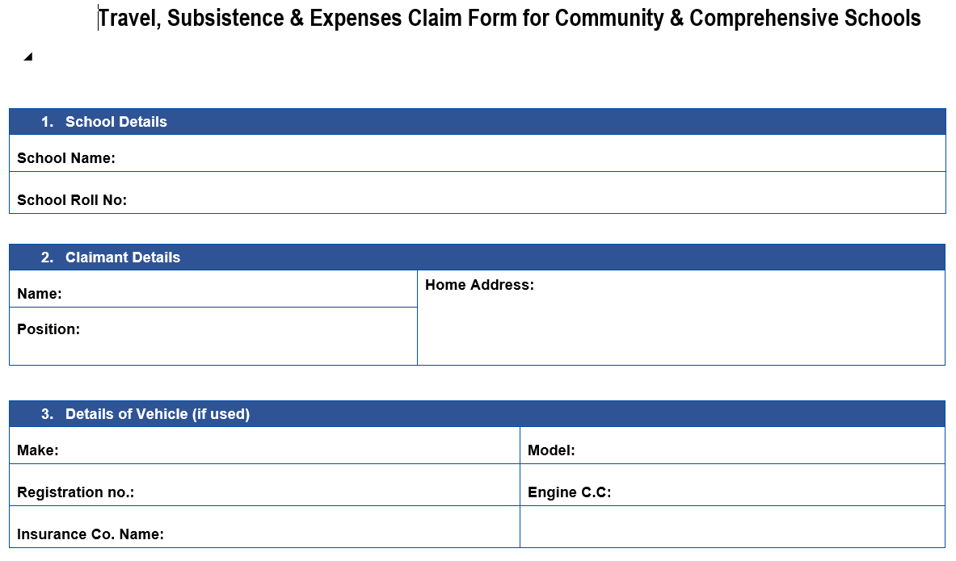
Travel, Subsistence & Expenses Claim form​
Notes:
As well as preparing a sample travel and subsistence policy for schools we also looked at updating the claim form. An updated claim form is available to download from our website.
I will take you through the claim form on screen now. Section 1 to 3 of the form states the school details, claimant details and the details of the vehicle if the claimant is claiming mileage.

Slide 24
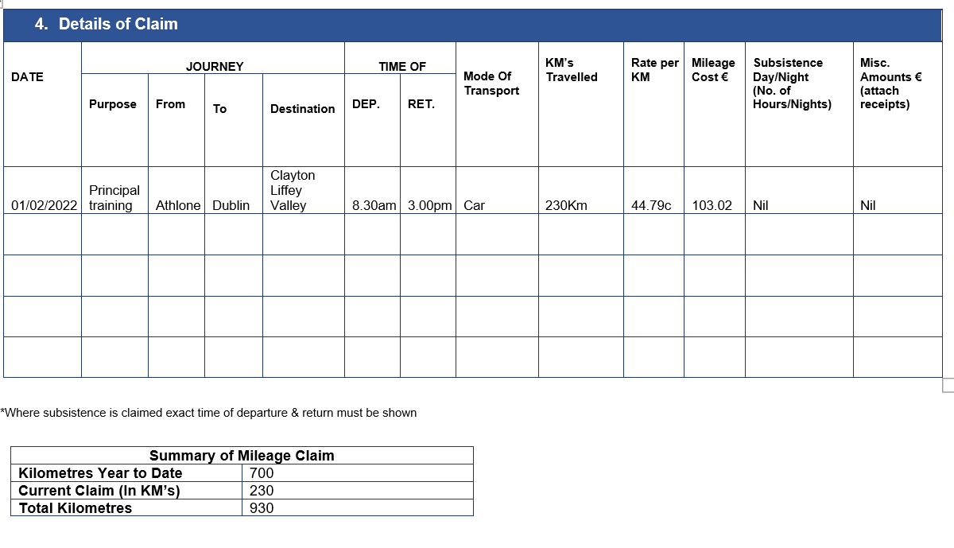
Travel, Subsistence & Expenses Claim form​
Notes:
Section 4 details the claim itself. If claiming mileage the purpose of the journey must be stated, the journey from and to and destination. Time of departure and return must also be stated.
Mode of transport is car where mileage is being claimed. The KM travelled should be the shorter of home to journey destination or place of work to journey destination. The recommended civil service mileage rates should be used for the rate per KM. These rates can be found on our website. The mileage cost is the KM travelled multiple by the rate per KM.
If subsistence is been claimed, the hours of hours/nights away should be entered. If any other expenses are been claimed the amount must be entered in the last column and the receipts attached.
In the bottom section of the sheet there is a box to enter cumulative mileage this must be completed by the claimant.

Slide 25
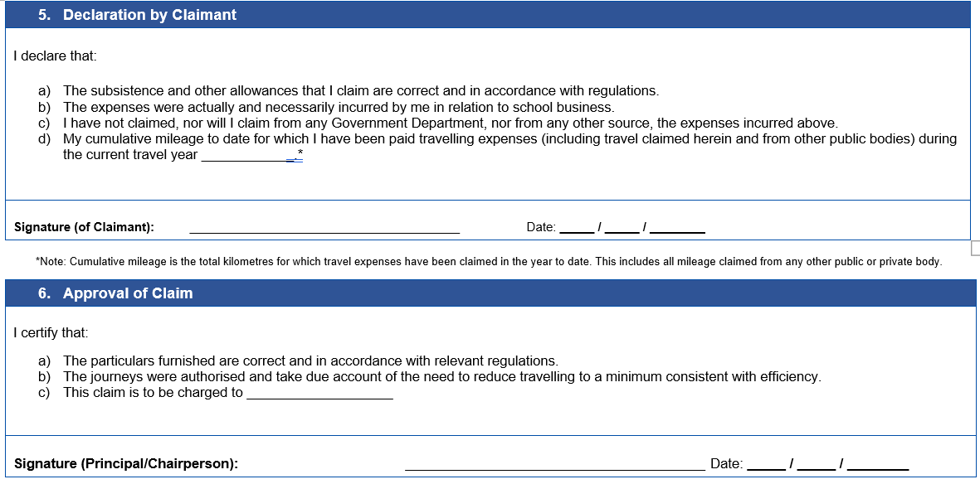
Travel, Subsistence & Expenses Claim form​
Notes:
In section 5 the claimant must read the declaration, complete the cumulative mileage to date and sign it. It is the responsibility of the individual claimant to ensure that the cumulative mileage is entered correctly. The cumulative mileage includes mileage travelled for other schools or organisation for which the individual has claimed travel for. The mileage travel bands are attached to an individual in the same way as tax cuts off and tax credits are.
Section 6, the Principal reviews the claim and approves it. But where the principal is making a claim, the chairperson must review the claim and approve it.

Slide 26
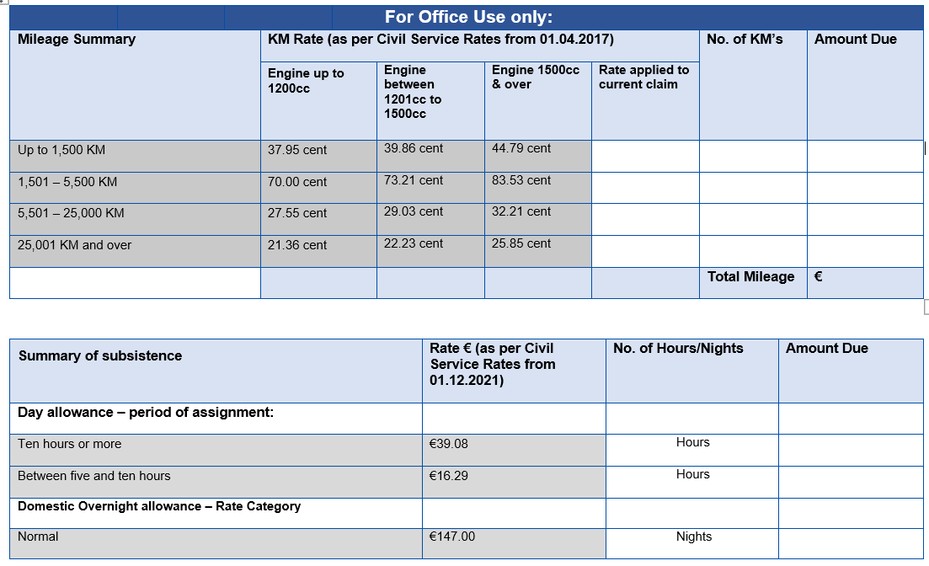
Travel, Subsistence & Expenses Claim form​
Notes:
The last section is for office use only and it is new to the form. This allows the accounts secretary to record the rate at which the mileage and subsistence has been paid and to record the amount paid and when it was paid These claim forms must be kept for a period of seven years.

Slide 27
Accounting for VAT Reverse Charge
Schedule 2
Minority of Schools –
School is VAT registered in respect of its taxable supplies of goods or services or purchases of goods from other EU member states
Schedule 1
Majority of Schools -
School registered solely for the purpose of RCT on Construction Services
Revenue Commissioners: The VAT treatment of the procurement of certain Goods and Services by a Public Body
Guideline 25-2020/2021
Notes:
Moving on to talk about vat.
In March of last year the Revenue Commissioners issued updated guidance on the VAT treatment of the procurement of certain Goods and Services by a Public Body:
The updated guidance has resulted in a change of practice in how schools should account for VAT on purchases from another EU member country from March 2021.
The revised procedure is set out in schedule 1 and schedule 2 of guideline 25 of 20/21 for post primary schools

Slide 28
Accounting for VAT Reverse Charge
Schedule 1
School is VAT registered solely for the purposes of RCT
From March 2021, a school is only accountable for the Reverse Charge VAT on services supplied by a subcontractor
Notes:
Looking firstly at schedule 1 where a School is VAT registered solely for the purposes of Relevant Contract Tax (RCT) on construction services supplied by a sub-contractor. This will apply to the majority of schools
From March 2021 the school is only accountable for the Reverse Charge VAT on services supplied by a sub-contractor.
Schools registered for VAT solely for the purposes of reverse charge construction services are not obliged to self-account for VAT on goods they purchase from other EU Member States, (including Northern Ireland).

Slide 29
Accounting for VAT Reverse Charge
Schedule 2
School is VAT registered in respect of its taxable supplies of goods or services or purchases of goods from other EU Member States
Taxable supplies of goods over €75,000 in a 12 month period
Taxable suppliers of services over €37,500 in a 12 month period
Value of goods acquired from other EU Member States over €41,000 in a 12 month period
Example a school tuck shop with a turnover of €75,000
Financial Guideline 2013/2014 – 09 ‘VAT on Rental Income from Sports Facilities & Car Parks’
Example a school purchases laptops from a German supplier for €41,000
Notes:
Looking then at schedule 2
Schedule 2 sets out the criteria for when a school will be obliged to register for VAT on the supply of taxable goods or services. This will apply to a very small minority of schools.
The criteria for registration is as follows
• where a school makes taxable supplies of goods over €75,000 in a 12-month period;
For example, a school tuck shop with a turnover of over €75,000, or
• it makes taxable supplies of services over €37,500 in a 12-month period. There is specific guidance where a school is in receipt of rental income from sports facilities and car parks for further information on this see guideline 09 of 2013/2014 for post primary schools.
• where a school acquires goods or is likely to acquire, from other EU Member States (including Northern Ireland) and the value is more than €41,000 in a 12-month period.
For example, if the school purchases laptops from a German supplier for more than €41,000 in a 12-month period.
Where a school is registered for VAT as a result of the above and a school purchases goods and services from another EU Country including Northern Ireland, the school will be required to self-account for VAT on these goods or services. It is important to remember that this will only apply to a very small number of schools.

Slide 30
Impact of Brexit on purchasing goods from Britain
Purchase goods from outside the EU including Great Britain
GB retailer charges customs when you purchase the goods
GB retailer does not charge customs when you purchase the goods
An Post – will notify you of the parcel and the customs charges
Pay the charges to An Post, online or in the post office
Courier – will calculate the charges
Pay the charges to the courier
No further action required by the school before delivery
Notes:
In terms of Brexit and the effect its has had on the purchase of goods from Britain. When we spoke last year there was still a lot of uncertainly around this and how if would effect the schools. So Goods imported into the State by a school, from outside the European Union (including Great Britain but excluding Northern Ireland) are subject to VAT at the point of entry, at the appropriate Irish VAT rate. Since the 1st of January 2021, goods purchased from Great Britain are now considered imported goods.
Many of the larger Great Britain retailers will apply customs charges when you purchase your goods online, so no action is required by you before delivery.
For example, when buying from Amazon UK after Brexit, Irish shoppers will see an extra item at checkout on Amazon UK called the Import Fees Deposit. This is a combination of Irish VAT and any customs duties that are due. Amazon charges you the import fees and will arrange for them to be paid on your behalf to Irish Revenue.
Therefore – no further charges will be requested in Ireland by An Post or couriers
If you purchase from a Great Britain retailer who does not include the customs charges as part of the purchase cost, then the following will apply.
➢ For goods being imported by An Post: An Post will notify you if a parcel sent to you has incurred customs charges and you will need to pay the charges to An Post, online or in a Post Office, to receive the parcel.
For goods being imported by courier: The courier will calculate the amount of charges you owe. Most couriers pay the import charges directly to Revenue on your behalf and recoup the import charges from you on delivery of the parcel.

Slide 31
Impact of Brexit on purchasing goods from Britain
1
A school should not give their VAT number to a UK supplier
2
A school does not need to register for an EORI number
3
School do not need to account for VAT on purchase of goods from the UK on the VAT 3 return
Guideline 26-2020/2021
Notes:
Things to remember
firstly a school should not give its vat number to a UK supplier
Secondly Where a school is not commercially trading in imported goods it should not register for an EORI number. If you have already registered and obtained an EORI number, you should contact Revenue to let them know you do not require one and would like to deregister. You can do this through MyEnquiries,
Thirdly the school does not need to account for vat on the purchase of goods from the UK on the vat 3 returns.
If however you are one of the minority schools that is registered for vat because of schedule 2 trading activity then the above does not apply to you.
Guideline 26-2020-2021 goes through the impact of Brexit on purchasing of goods from Britain and this guideline can be found on our website.

Slide 32
Impact of Brexit on purchasing Services from Britain
Digital Products such as
e-books
test papers purchased online
software
The school should not supply the school VAT number to the UK supplier
Guideline 26-2020/2021
Notes:
In terms of services purchased from Britain and this would include the purchase of digital products such as e-books, test papers in a digital format and software products. Revenue confirmed that a school which is VAT registered solely for the purposes of accounting for VAT on construction services received would not have to account for Irish VAT on such services when received from outside the State. The UK supplier may charge VAT on their invoice depending on the service and supplier trading circumstances for example the supplier may have to register for Irish VAT if supplying over a certain limit. Again the important thing to note is that school should not supply their VAT number to the supplier

Slide 33
Relevant Contract Tax
Principal Contractor​
“any board or body established by or under statute … and funded wholly or mainly out of funds provided by the Oireachtas”.
Notes:
Principal contractors are defined in the legislation as “any board or body established by or under statute … and funded wholly or mainly out of funds provided by the Oireachtas”. And therefore School Boards of Management are principal contractors for the purposes of RCT.
We are going to take the opportunity today to refresh ourselves on the rules on RCT & VAT.

Slide 34
Relevant Contract Tax
RCT applies to:
Construction Projects​
Emergency & Summer Works​
Installation of prefabs​
Repairs to buildings incl. electrical, plumbing​
Maintenance contracts with repair element
Notes:
Boards of Management can be involved in a range of activities including: Construction Projects, Major Devolved Projects, Additional Accommodation Schemes, Summer Works, Emergency Works, COVID Minor works as well as day to day repairs that bring them within the scope of RCT and, as a consequence, VAT. It is important that boards are aware of and understand their obligations in relation to these taxes.

Slide 35
Relevant Contract Tax
Is RCT applicable ?
installing, altering or repairing: ​
security systems​
lighting systems​
heating systems​
air conditioning systems​
soundproofing systems​
ventilation systems​
power supply systems​
drainage systems​
sanitation systems​
water supply systems​
telecommunications systems​
Notes:
It is important to remember that RCT not only applies to the large construction projects it also applies to smaller jobs.
RCT will apply to the installation, alteration or repairs where the work carried out is integral to the building or structure of the school. The follow is a list of examples of when RCT will apply.
Where installation, alteration or repair work is carried out in any of the following areas.
Security systems, Lighting systems
Heating systems, Air conditioning systems
Soundproofing systems, Ventilation systems
Power supply systems, Drainage systems
Water supply systems & Telecommunication systems

Slide 36
Relevant Contract Tax
Is RCT applicable ?
Maintenance Only Contracts
Routine Cleaning
Computers & Hardware
Professional fees i.e. architect fees etc
Landscaping except where part of the build
Fittings e.g. cookers, dishwashers, desk, chairs, fitted carpet & lino other then floor covering stuck down
Notes:
RCT will not apply to
Maintenance only contracts
Routine cleaning
The Purchase of computers and hardware
Professional fees for example architect fees, engineers, quantity surveyor or design teams
Landscaping except where landscaping is carried out as part of rendering complete a construction project.
Fittings e.g., cookers, dishwashers, desk, chairs, carpet & lino except in the case where the floor covering is stuck down then rct does apply.

Slide 37
Relevant Contract Tax
1
Notify Revenue of all contracts online (Contract Notification)
2
Notify payment online (Payment Notification) – Penalties apply where prior notification to the Revenue is not obtained
3
Provide a copy or details of the Deduction Authorisation to the subcontractor when paying the subcontractor
Notes:
If you have identified an activity as falling within the scope of RCT then the following must be done.
Firstly, you need to notify revenue of the contact, by completing a contract notification on ROS. For this you will need the subcontractors name, tax registration number, the nature of the work being carried out, the estimated value of the contract and the start and finish date. A contract notification must be submitted to Revenue before any payments under that contract can be notified to Revenue.
Before the subcontractor can be paid, a payment notification must be entered on ROS. Revenue will respond to the payment notification with a deduction authorisation, setting out the rate of tax to be applied to the payment and how much tax, if any, must be withheld from the payment. The rates of tax are set at zero, 20% or 35%. It is vitally important that the payment notification is only done on the day on which the payment is actually been made.
If tax is to be deducted, the principal contractor must provide a copy, or details, of the deduction authorisation to the subcontractor.
If payments are made to subcontractors without a payment notification been submitted to Revenue penalties apply.

Slide 38
Reverse Charge VAT
If RCT applies VAT applies
VAT to be accounted for by the Principal Contractor
School’s must account for VAT at 13.5%
Notes:
Moving on now to look at VAT. The rule of thumb here, is if RCT applies then VAT will need to be accounted for.
When you receive an invoice from a subcontractor, that invoice must contain the statement “VAT to be accounted for by the Principal Contractor”.
The VAT is calculated by the school at 13.5% and returned to revenue on the VAT 3 return, as VAT on sales. It is important to note that the VAT liability is based on the invoice date.

Slide 39
School Budget
School Budget Preparation 2022/2023
Notes:
We will now move on to look at the school budget
In accordance with the Governance Manual for Community & Comprehensive schools, schools are required to prepare an annual budget each year and following agreement by the board of management to submit it to the school’s Patron/Trustees for approval. The budget must be submitted to the Department of Education on or before the 30th June. The FSSU does not require a copy of the school budget.

Slide 40
School Budget
Objectives of budgeting
Meet statutory requirements
Control financial resources
Effective decision making
Achieve schools educational & administrative objectives
Maximise use of available resources
Assist the Principal to manage the finance on a day to day basis
Notes:
The objectives of financial budgeting are as follows.
To ensure the schools meets it statutory requirements
To maximise the use of available resources
To assist in effective decision making
To help the school to achieve its education and administrative objectives in accordance with its ethos and mission.
To control & ensure maximum use of the school’s financial resources.
And to assist the principal to manage the financial resources on a day-to-day basis.

Slide 41
School Budget
Key Points:
Expenditure can not exceed Income​
Reviewed by the finance sub-committee
Approved by the board​ of management
Submit to Trustee​/Patron
Must be submitted to the Department by the 30th June
On going monitoring of the budget
Notes:
Some key points on the school budget are
Expenditure can not exceed income. A school is not permitted to budget for a deficit without trustee/patron approval and must explain how the deficit is to be funded.
The finance sub-committee must review the budget.
The budget must be approved by the board of management before it is submitted to the school’s Patron/Trustees for approval. Again the budget must be submitted to the Department of Education on or before the 30th June.
On going monitoring of the budget is critical to ensure that budgets are adhered too and eliminates ad hoc decision making.

Slide 42
School Budget
Notes:
I am going to head you over now to Eileen you will take you through the budget worksheets.

Slide 44
Contact Us​
Eileen Ahern
Accountant
Lorraine Guinan
Accountant
FSSU Office
Mobile:
086-8519116
Email:
eileenahern@fssu.ie
Mobile:
086-7018874
Email:
lorraineguinan@fssu.ie
Mobile:
01-2690677
Email:
info@fssu.ie
Notes:
If we missed any questions we will address them in an Frequently Asked Questions document, which we will put up on the website in the next couple of days, or if you have any further queries on any of the financial update topics or require assistance with your budget template, please do not hesitate to contact us directly.
The recording and presentation slides will be available on the website and you will get an email with a link to those in the next 24 hours.

Slide 45
Thank you for joining the webinar
If you have any further questions
please telephone or email us
Post Primary 01 269 0677
Email info@fssu.ie
Notes:
On behalf of the entire FSSU team thank you for your attendance and have a very good day☺

