Slide 1
Year End Template Checklists

Slide 2
Year End Template Checklist
Accounts / Template Checklist
Opening bank balances
Cheques brought forward from previous year
Closing balances
Reconcile all bank accounts to zero
Compile list of all uncashed cheques
Uncashed cheques - review cheques out of date
Review of reports - ensure consistency with categories selected
Payroll reports - Revenue
Petty Cash
Credit Card Statement
Bank Statements

Slide 3
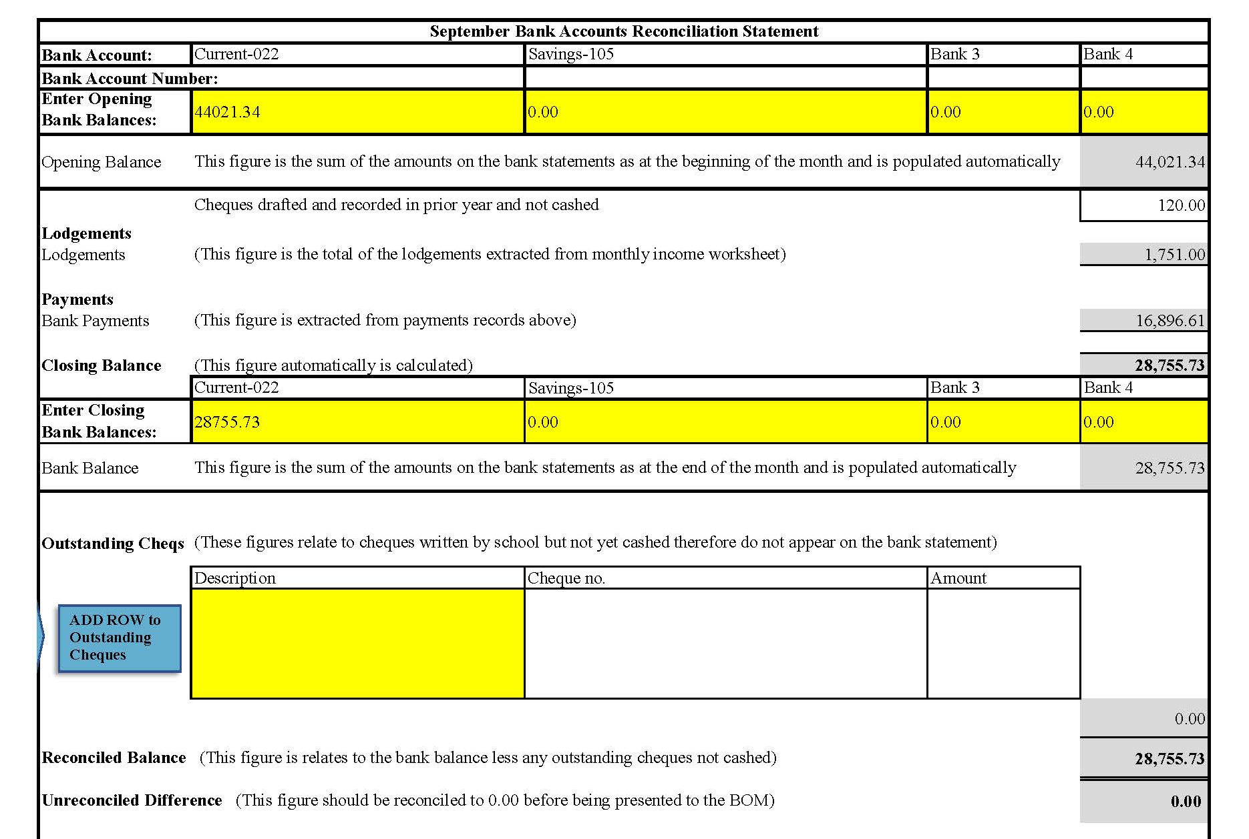
Year End Template Checklist
Check opening bank balances and cheques brought forward from previous year

Slide 4
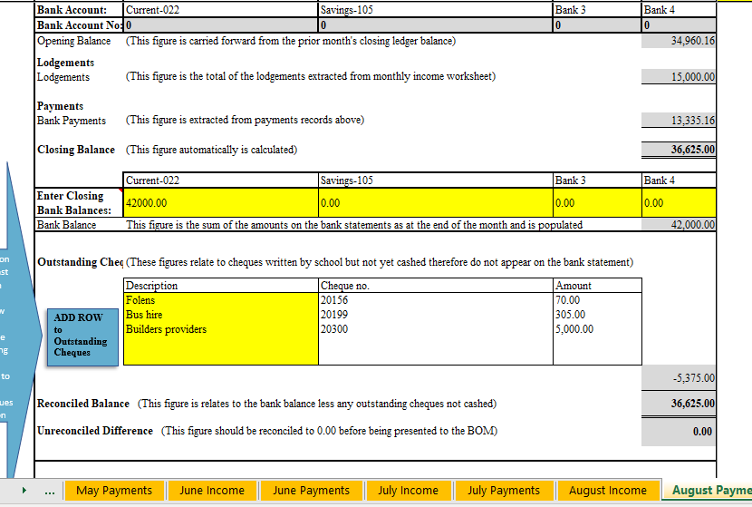
Year End Template Checklist
Check all cheques written in the year have been entered
Check closing balances and reconcile all bank accounts to zero
Compile list of all uncashed cheques

Slide 5
Year End Template Checklist
Review list of uncashed cheques
Write back any cheques older than six month, or which you don’t expect to be presented.

Slide 6
Year End Template Checklist
Be sure to compile a list of outstanding cheques
Description | Cheque no. | Amount
Folens | 20156 | 70
Bus hire | 20199 | 305
Builders providers | 20300 | 5000
 | Total | 5375

Slide 7
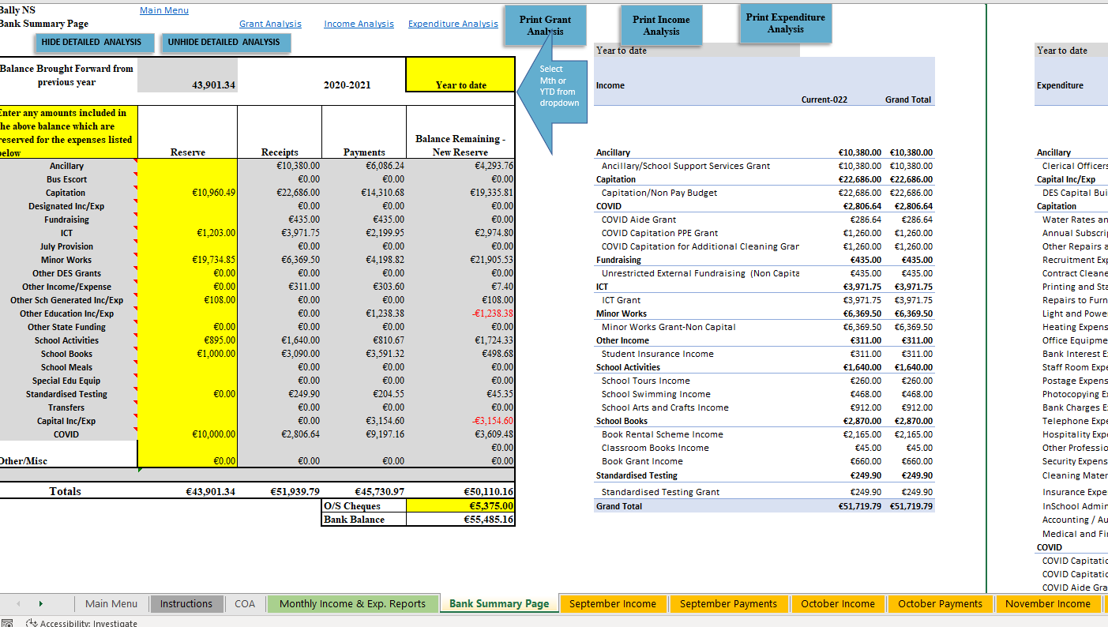
Year End Template Checklist

Slide 8
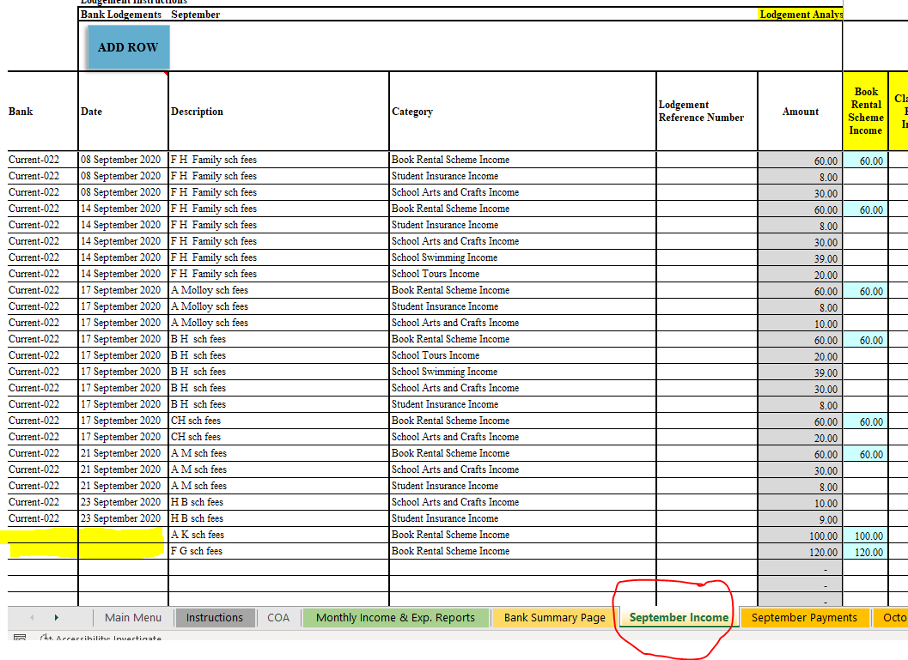
Year End Template Checklist

Slide 9
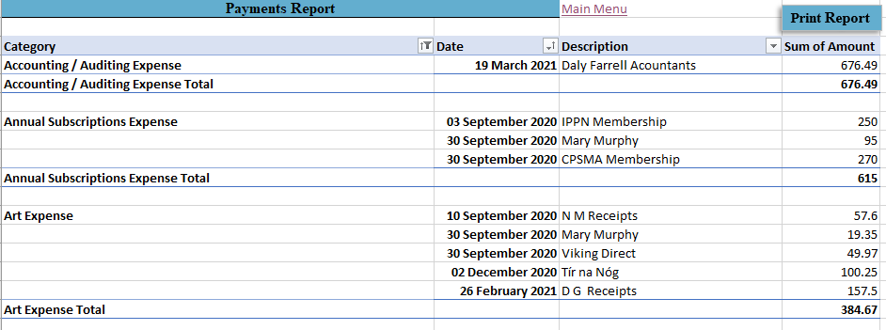
Year End Template Checklist

Slide 10
Year End Template Checklist
ICT Grant
Minor Works Grant
School Book Grant
Standardised Testing Grant
COVID-19 Grant
Capital Grant
Any other specific grant received
See Financial Guideline P12 - 2020/2021

Slide 11
Year End Template Checklist
Payroll Reports
Petty Cash
Credit Card Statements
Bank Statements

Slide 12
Thank You
If you have any further questions
please telephone or email us
Monday-Thursday 9-7
Friday 9-5
FSSU Primary 01 910 4020
Email primary@fssu.ie

