Slide 1
Financial Support Services Unit

Slide 2
Support from the FSSU

Slide 3
Role of FSSU
Provision of advice and support to schools on financial governance matters
Development of templates for use by schools
Acting as a central repository for receipt of annual Board of Management accounts prepared by an external accountant.
Carrying out of audits as may be required.
Preparation of an annual report for the Department of Education & Skills (DES)
Liaison with the DES in relation to financial matters pertaining to Primary schools
Submission of financial information to the Charities Regulator which will also satisfy the financial reporting obligations placed on schools by the Charities Act 2009
Provision of statistical information to the Central Statistics Office (CSO) in relation to its requirements for financial information in respect of the school system
DES Circular 60/2017

Slide 4
FSSU Roll Out Timeline
2017/18 school year
FSSU focused on provision of advice and support as part of preparations for the phased introduction of the standardised national template for annual school accounts.
2018/19 school year
This will be the first year for annual school accounts to be prepared using the standardised national template.
End February 2020
This will be the latest date for annual school accounts for the 2018/19 school year to be submitted to the FSSU.
Annually thereafter
Annual School Accounts to be submitted to the FSSU in the prescribed format by the end of February (6 months after the end of the school year).

Slide 5
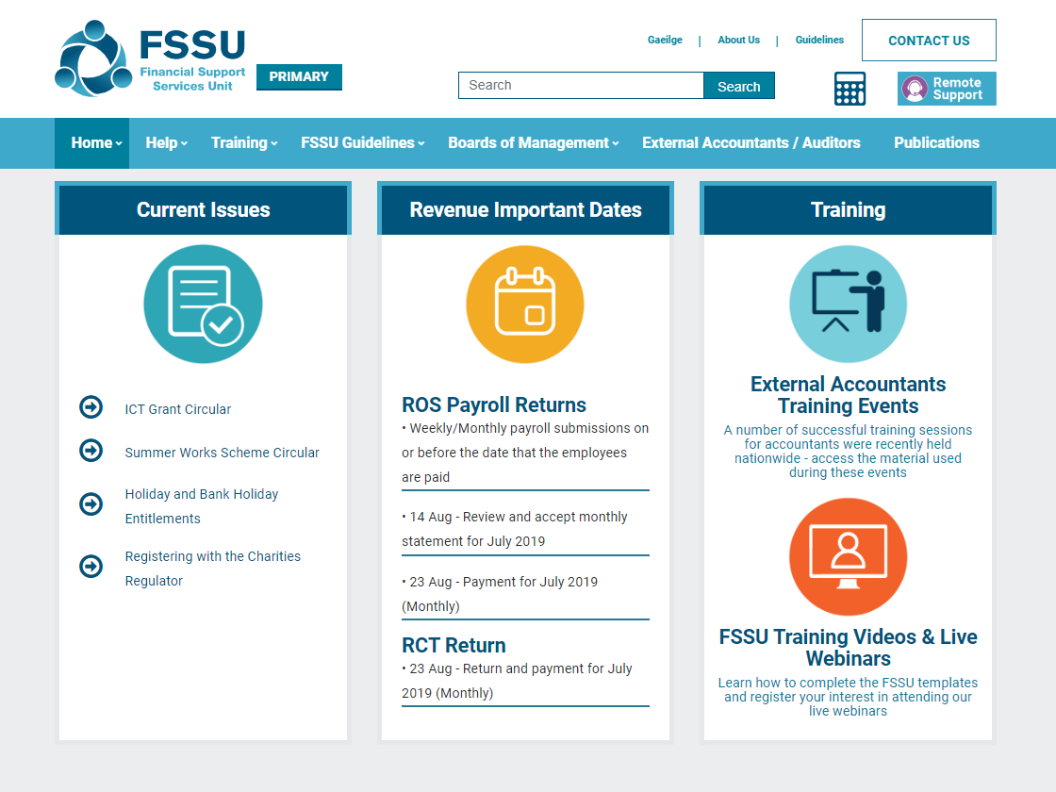

Slide 6
Internal Financial Controls
Payment Controls
Cheque Signatories
Supporting Documentation
Income Controls
Revenue Compliance
Charities Regulator

Slide 7
Reports for Board of Management Meetings
FSSU Monthly Reporting Templates
Monthly School Income & Expenditure Report
Year to Date Report – Actual v Budget
Year to Date Report – Actual v Prior Year Actual
Other Information
Bank Reconciliation Statement
Payroll Report – Reporting on Gross to Net Wages
List of Outstanding Invoices to be Paid
Accruals and Prepayments
Capital Project Updates

Slide 8
Revenue Compliance
Payroll
Payroll operated for Board paid staff only
PAYE Modernisation was a big issue for Boards
Payroll Software
Outsource Payroll
Self Employed Versus Employee
ASC (i.e. relevant for external interview panellist / principals) payable to Department of Education & Skills

Slide 9
Revenue Compliance
RCT / VAT
School obliged to register for RCT / VAT
Public Body - Not allowed to claim a VAT input credit
Revenue Guidance Note “Boards of Management – Relevant Contracts Tax/Value Added Tax”
File RCT / VAT via ROS and make payments to Revenue
School potentially subject to Revenue Audits

Slide 10
FSSU Online Submission
A new system of online submission of accounts has been approved by the Department of Education and Skills. The submission will come into operation for school accounts from the year ended 31st August 2019 (this school year).
The board of each primary school, facilitated by an external accountant/auditor, are obliged to make a submission no later than the 28th of February 2020 and annually thereafter.
Online portal at www.fssu.ie
All external accountants will be linked to their schools
The portal will be prepopulated with school information such as School Roll Number, School Name and School Address
Further training will be provided in late 2019

Slide 11
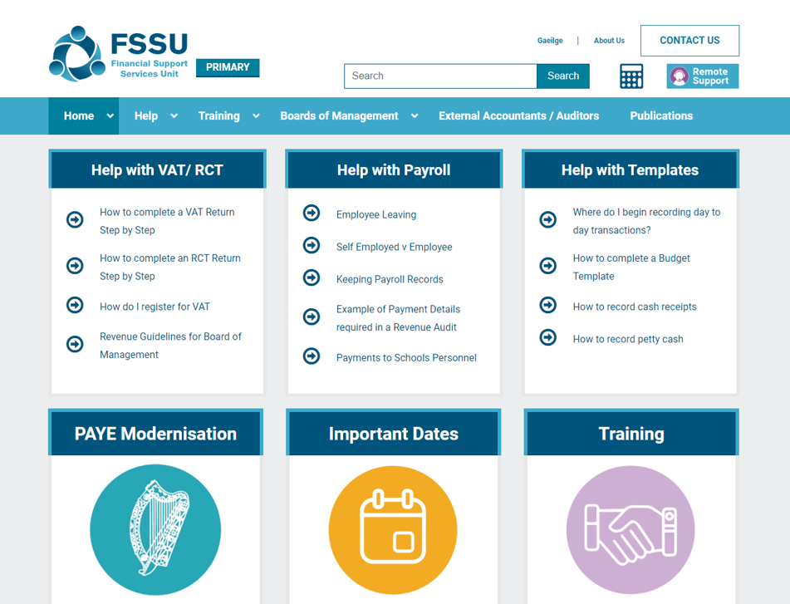
Completing the Budget Template
1. Download the Budget Template from www.fssu.ie
2. Save the file and Enable Editing

Slide 12
Using the
Monthly Reporting Template
Data Input and Reporting

Slide 13
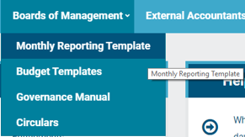
Monthly Reporting Template
Download the Monthly Reporting Template from www.fssu.ie
Save the file - Enable Editing and Enable Content

Slide 14
Contact Us
Support Line
01 910 4020
Open 9am to 7pm
Website
www.fssu.ie
Email
primary@fssu.ie

Slide 15
Questions
Comments
Support Line I 01 910 4020
www.fssu.ie

